Slide 1
CIVIL ENGINEERING – BUILDING THE FUTURE
they build our quality of life.
With creativity and technical skill, civil engineers plan, design, construct and operate the facilities essential to modern life, ranging from bridges and highway systems to water treatment plants and energy efficient buildings
Civil engineers are problem solvers,meeting the challenges of pollution, traffic congestion, drinking water and energy needs,urban development and community planning.
1

Slide 2
Continues…….
From the functional and beautiful Golden Gate Bridge in the UnitedStates, Petronas Towers in Malaysia, and Pont du Gard in France to the largely hiddenwater supply and sanitary sewer systems, civil engineers have made their mark in many aspects of the daily life of essentially everyone around the globe.

Slide 3
CIVIL ENGINEERING
Entrusted by society to create a sustainable world and enhance the global quality of life, civil engineers serve competently, collaboratively, and ethically as master:
Planners, designers, constructors, and operators of society’s economic and social engine – the built environment
Stewards of the natural environment and its resources
Innovators and integrators of ideas and technology across the public, private, and academic sectors
Managers of risk and uncertainty caused by natural events, accidents, and other threats and
• Leaders in discussions and decisions shaping public environmental and infrastructure policy.

Slide 4
Infrastructure
Framework of supporting system - transportation, energy, communication, lifeline facilities, irrigation facilities, etc., for the economic development of a country by the growth of industrial and agricultural fields.
Economic infrastructure contributes directly &indirectly- to the economic development of the country

Slide 5
Infrastructure
reliable and sustainable public infrastructure - critically important
Our public infrastructure helps connect communities, drives our economy and keeps us healthy and safe.
Engineers play a critical role in planning, developing, building and maintaining our public infrastructure stock.

Slide 6
The infrastructural development has the following major impacts on a country……..
Increase in food production
Protection from drought, famine, flood
Healthy and comfortable housing facility
Safe domestic and industrial water supply
Safe and scientific waste disposal
Improvement in communication and transportation
Generation of electricity from, nuclear, hydel, thermal, solar or wind energy

Slide 7
major impacts….
Improved, wealth, prosperity, standard of living
Overall growth of a nation
Urban growth lead to –
  population drift
  explosion in population in cities
  inadequate development of villages
  improper care for agricultural sector

Slide 8
major impacts……
Use of infrastructural facility only by upper class - imbalance.
Demands for
  sustainable energy,
  fresh water, clean air, and
  safe waste disposal - global infrastructure development.

Slide 9
major impacts……
Large-scale budget allocation for infrastructure - agricultural and industrial developments
It provides
  employment
  eradicates poverty and
  enhances per capita income.

Slide 10
Role of Civil engineers in Infrastructural development are…
critical role in –
  planning, developing, building and maintaining our public infrastructure stock.
Decommissioning--
Construction of roads, railway, ports, harbors and airports
Construction of dams & bridges and proper utilization of water resources

Slide 11
Role of Civil engineers …
• Construction of Housing, commercial and industrial complexes
development of water treatment facilities, the electricity grid
Maintenance of these facilities
Rebuilding, Rehabilitation, Retrofitting and Repair
the engineering profession uses its expertise, experience and knowledge to help create a safer, more sustainable, and prosperous future.

Slide 12
Role of Civil engineers …
Engineers balance
  social,
  environmental and
  economic considerations
    to find the best solutions to complex challenges.
Engineers - committed to having the skills and knowledge –
  they need to safely and effectively design physical infrastructure
  to meet the changing needs.

Slide 13
Role of Civil engineers …
The outcome of that
commitment, combined with strict adherence to standards, codes, legislation and regulations
People enjoy a high standard of safety and reliability in their infrastructure.

Slide 14

Engineers balance social, environmental and economic considerations to find the best solutions to complex
Engineer overseeing construction
progress

Slide 15
Role of engineer…..
As part of a multidisciplinary team, engineers collaborate with other professions and specialists, such as surveyors, architects, technologists, land-use planners, natural scientists, ecologists, geologists, archaeologists, economists, construction specialists, property negotiators, lawyers, decision-makers and others.
Together, their work serves to plan and develop the best infrastructure
Engineers also play an important role with regulators, ensuring compliance with building codes, labour laws, environmental approvals and other requirements.

Slide 16
Role of engineer…..
engineers key to quality infrastructure
infrastructure is an investment – an investment in the economic, social and environmental prosperity of this country
As a result, the engineering profession is committed to lifecycle design and an active promoter of sustainability.
High quality, reliable infrastructure can only be maintained if engineers and public infrastructure owners understand the full lifecycle needs of their investments, and adopt sound asset management practices

Slide 17
Role of civil engineer…..
Good asset management – which includes
engineers and others – allows us to measure the condition and remaining service life of existing infrastructure. It means constant monitoring and planning of transportation, environmental, health and education infrastructure needs.
There are many factors to think about: the condition of current infrastructure, future needs, adaptation to climate change, and population growth.

Slide 18
Infrastructure in India…
Infrastructure development in any country contributes to the economic development of a particular nation.
Higher the infrastructure facilities higher will be the growth prospects.
Infrastructure is a major sector that propels overall development of the Indian economy
India is on the verge of change which can be observed on several basis such as higher standard of living, globalization, infrastructure expansion etc.
The Secretariat for Infrastructure in the Planning Commission is involved in initiating policies that would ensure time-bound creation of world class infrastructure in the country.

Slide 19
Infrastructure in India…
“Expanding investment in infrastructure can play an important counter cyclical role. Projects and programmes [are] to be reviewed in the area of infrastructure development, including pure public private partnerships, to ensure that their implementation is expedited and does not suffer from [the] fund crunch.”
Mr. Manmohan Singh, Indian Prime Minister,
(quoted in newspaper reports, October, 2008)

Slide 20
“The link between infrastructure and economic development is not a once and for all affair.
It is a continuous process; and progress in
development has to be preceded, accompanied, and followed by progress in infrastructure, if we are to fulfill our declared objectives of generating a self-accelerating process of economic development.”
Dr. V. K. R. V. Rao [noted Indian economist, early 1980s]

Slide 21
Projected spending from FY07-FY12 in selected infrastructure segments:
• Electricity: US$167 billion
• Railways: US$65 billion
Road and highways: US$92 billion
Ports: US$22 billion
Airports: US$8 billion
One of the world’s fastest growing economies – and growth expected to continue at 7-7.5% despite the global downturn.

Slide 22
Growing private public partnerships
According to the World Bank, India is second only to China in terms of the number of Public Private Partnership (PPP) projects.
During the 12th Five-Year Plan, the target is to achieve 47 per cent of total infrastructure investments through private funding, up from 25 per cent in the 10th Five-Year Plan
Indian government planned to build 100 smart cities. The government has allocated US$ 1.2 billion for this project in its 2014-15 budget. This plan would need more PPP’s for better and fast execution

Slide 23
Concluding Remarks….
Civil engineers served, serving and will serve as master builders, environmental stewards, innovators and integrators, managers of risk and uncertainty, and leaders in shaping public policy.
Civil Engineering is about community service, development, and improvement .
In essence, Civil Engineering may be regarded as the profession that makes the world a more agreeable place to live

Slide 24
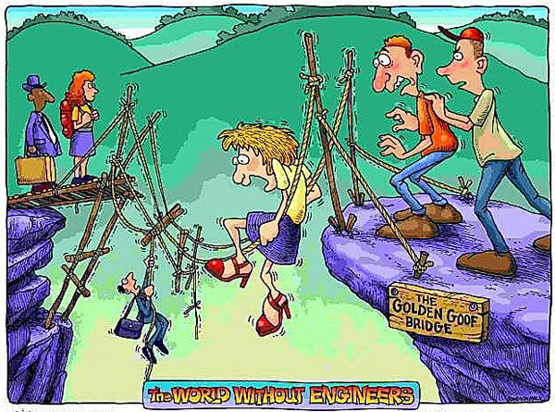
World without engineers…..

Slide 25
ROLE OF CIVIL ENGINEERS………
Infrastructure without engineers is like an education system without teachers or a health care system without doctors – impossible.
they quietly shape the history of nations around the world.
Most people can not imagine life without the many contributions of civil engineers to the public’s health, safety and standard of living.
Only by exploring civil engineering’s influence in shaping the world we know today, can we creatively envision the progress of our tomorrows.

